Slide 1
Light Following Car

Slide 2
Introduction
In present time, robotics is one of the important fields in modern and technological world for the design, construction, operation and application of robot. Before 20th century this sector was not developed successfully. Today the research, design, building of new robots used in different domestic, commercial, military sectors are developing the applications of robotics day by day. A Robot, in general an electromechanical & computer programming using power and control machinery device that can perform takes automatically depending on sensors. This project is designed to build obstacle avoidance at the same time light following robotic vehicle using ultrasonic sensor for its movement & LDR module to decide the path to follow according to the light falls on it. An Arduino Uno R3 is used to achieve the desired operation. Ultrasonic sensor is used to detect any obstacle ahead of it and sends a command to the Arduino. LCR is used such that the amount of light falling on it, from every direction will be calculated and then it will find out the direction from which the light with maximum intensity falls on it. Then it moves in that direction only. L298N motor driver is used to increase the current by which we can drive the DC motors.

Slide 3
DESIGN OF THE SYSTEM:
1
The entire circuit diagram has two major sections. One is Light following with the help of LDR module & another is Obstacle detection with the help of Ultrasonic sensor

Slide 4
Components List:
LDR Sensors
LDR’s are used to detect the light falling on the robot. One terminal of the diode is to be connected to the +VCC and another terminal should be connected to the input of the L293D IC.
L239D Motor Driver IC
The L293D is an 16pin IC which is mainly used to drive the motor. Here the motor will run only when the pin2 of L293D IC is 1. The IC is mainly used to drive the motors for robot movement.
Breadboard
One breadboard is used for designing the circuit. The electronic components are connected by inserting it in the holes of the breadboard (or) use a PCB to solder the components.
Motors
It operates on command of the L293D IC. the motor will be activated on the basis of the signal.
Battery 9V
One 9V battery will be sufficient for powering the robot. For more usages, two pairs of 9V battery may be required because the motor will drain the battery very soon.
LM 7805 IC
One IC 7805 voltage regulator is incorporated for allowing 5v of power supply to the circuit instead of 9v.
7432 IC
OR Gates IC for Combinational Logic.
7408 IC
NOT Gates IC for Combinational Logic.
7404 IC
AND Gates IC for Combinational Logic.

Slide 5
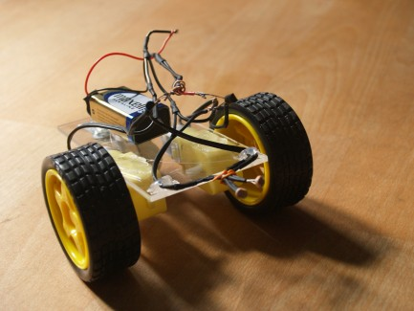
Working
First, we take the LDR’s and check them for their working condition. We are using a battery of 9v hence we need to use a LM7805 IC (5v regulator IC). And we used a switch in order to switch ON and OFF the system. Connect the wheels for motor movements , two wheels at back side and castor wheel at the front side for easy rotation of the robot. Now connect the one terminal of the LDR to the +VCC. And another terminal to the L293D IC. This L293d IC is capable of driving two motor at a time (clock and anti-clock wise). Then connected the L293D IC to the wheels as well to the LDR’s. Switch ON for the operation of the robot.

Slide 6
Truth Table
S1 | S2 | S3 | Motor Left | Motor Right
0 | 0 | 0 | 0 | 0
0 | 0 | 1 | 1 | 0
0 | 1 | 0 | 1 | 1
0 | 1 | 1 | 1 | 0
1 | 0 | 0 | 0 | 1
1 | 0 | 1 | X | X
1 | 1 | 0 | 0 | 1
1 | 1 | 1 | 1 | 1

Slide 7
Equation:
The equation for Motor left obtained by K-Map SOP form is:
ML = S3 + S1° . S2
The equation for Motor Right obtained by K-Map SOP form is:
MR = S1 + S2 . S3°

Slide 8
Uses of Future:
The use of LEDs has revolutionized lighting tech for cars. Light Emitting Diodes, to give them their proper name, are tiny semi-conductors that generate bright light when you pass an electric current through them. They’re perfect for use in vehicles, simply because they don’t heat up much, they’re small and light, and they’re far more reliable and long-lived than conventional bulbs. Indeed, they’re so efficient that they actually help you pay less motor tax every year.
“Future lighting technologies will offer even higher resolutions. Therefore, they will allow an even more detailed controlling of the light for better road illumination for the driver as well as glare incidents which are further minimized.”

Slide 9
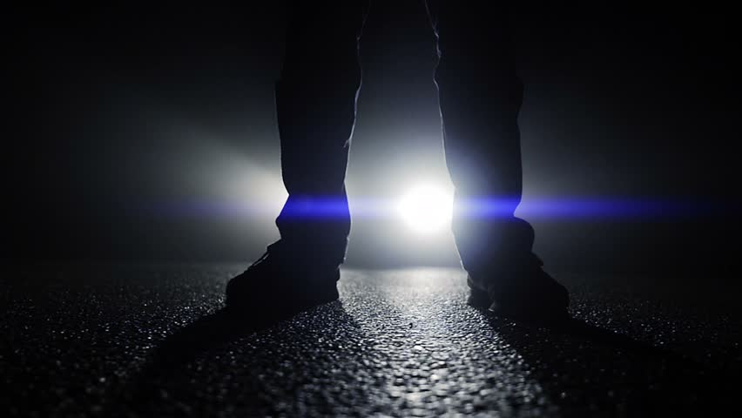
A picture is worth a thousand words
You got to be able to reinvent yourself and come up with new ideas because everybody is going to try to copy, which is what you want. You want people to start saying what you say.

Slide 10

Want big impact?
Use big image.

Slide 11
“There are no new ideas. There are only new ways of making them felt”

Slide 12
Thanks!

Slide 13
Credits
Muzamil Khan
Sameed Ahmed Khan
M.Saad Haleem

